Slide 1


Slide 2

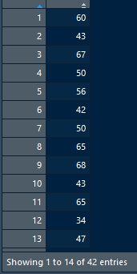
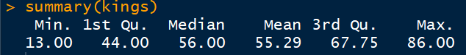
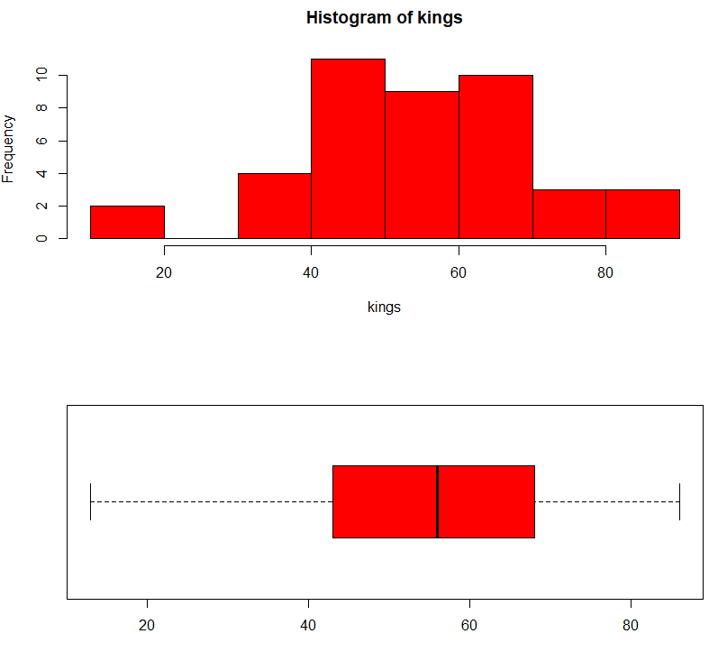

Data: kings

Slide 3
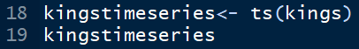
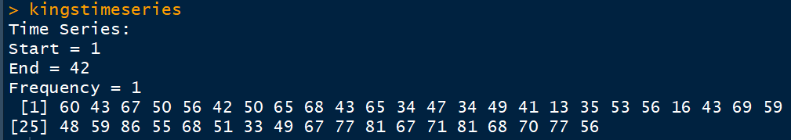

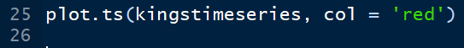
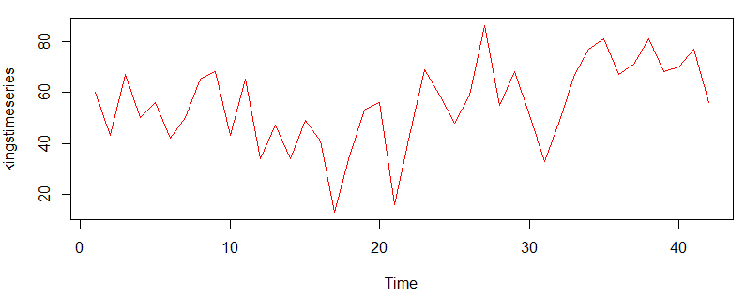
Data: kings
Trend, Cycle, Seasonality NOT EXISTING. Randomness is roughly constant!

Slide 4
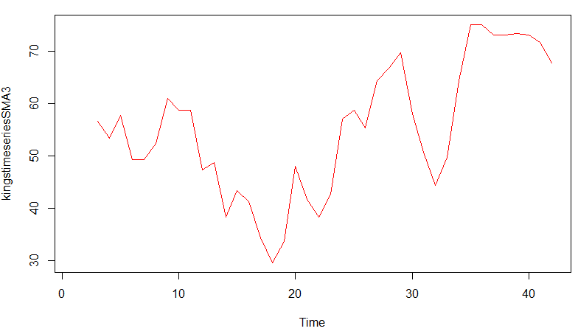
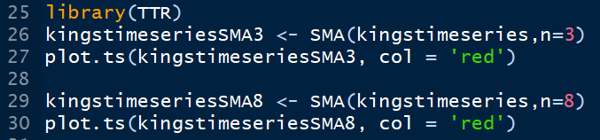

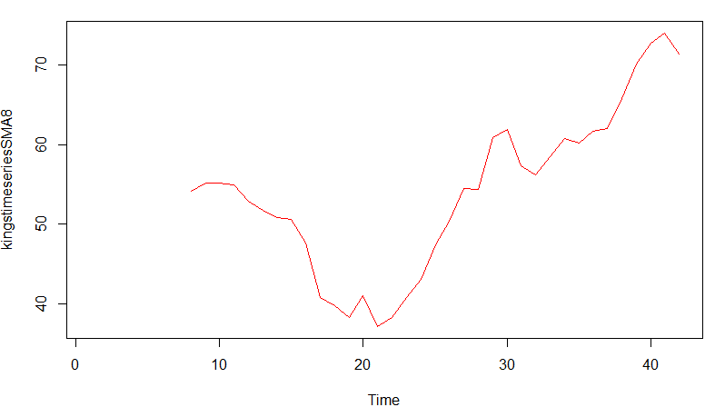

Moving Average: kings
N = 3
N = 8
N = 3 is good OR N= 8 is good?

Slide 5
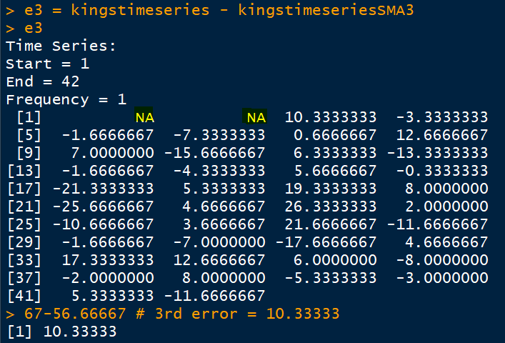
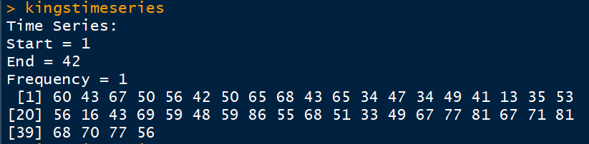
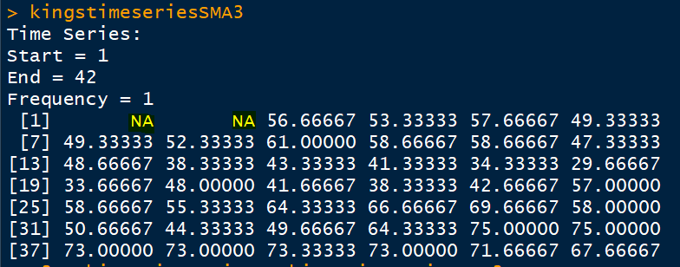
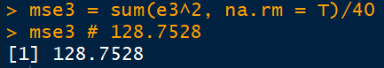
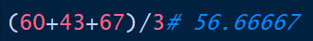

MSE [n= 3]

Slide 6
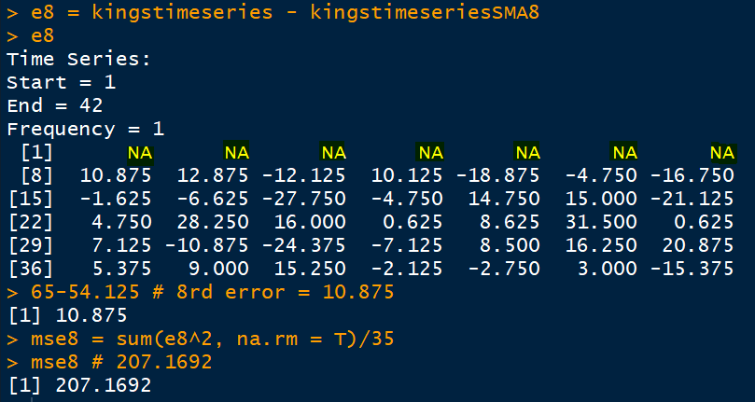
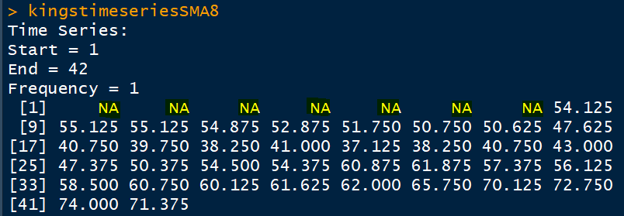
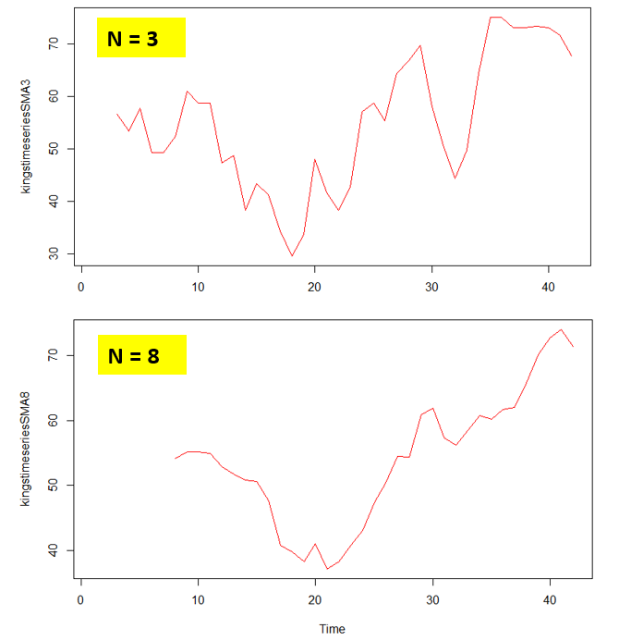

MSE [n= 8]
7 NAs

Slide 7
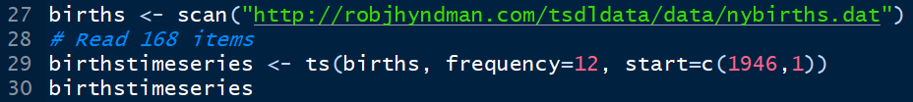
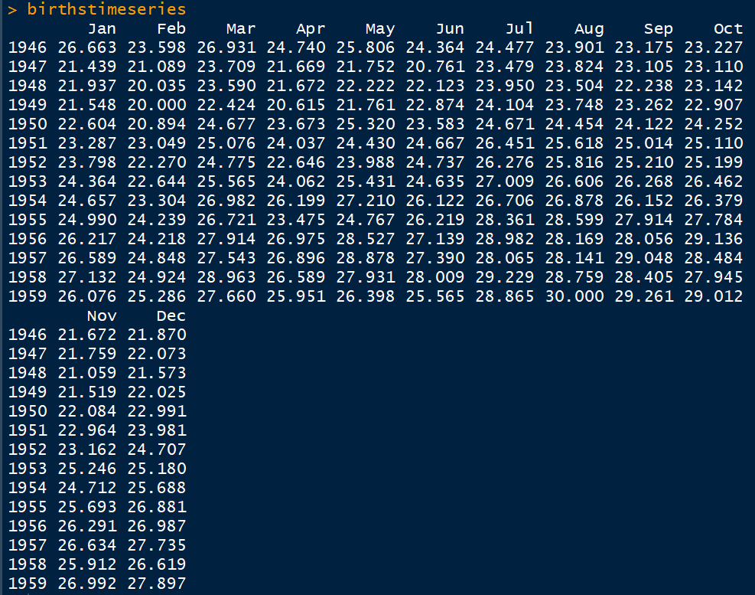
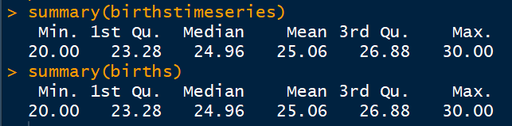
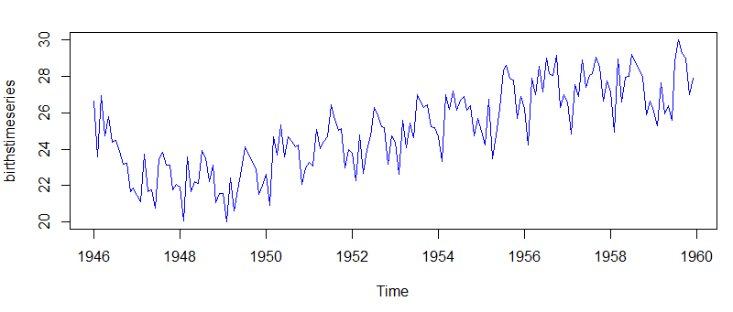
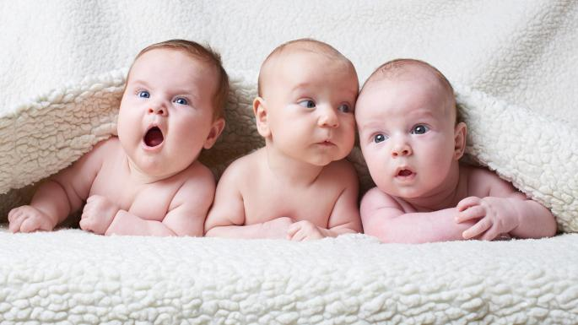
Data: births

Slide 8
Data: births
Peak in summers
Trough in winters
Seasonality exists

Slide 9
Kings vs births
Very small Trend (ignorable), No Cycle, No Seasonality, randomness is roughly constant
Trend exists, No Cycle, Seasonality exists, randomness is roughly constant

Slide 10
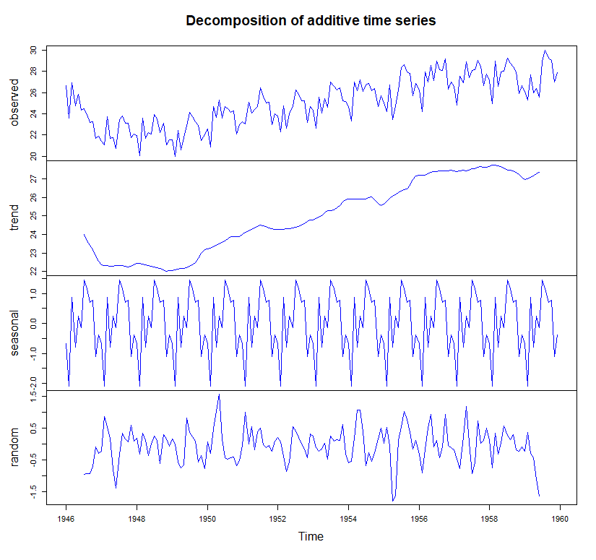
Data: births
Trend exists, No Cycle; Seasonality exists, randomness is roughly constant

Slide 11
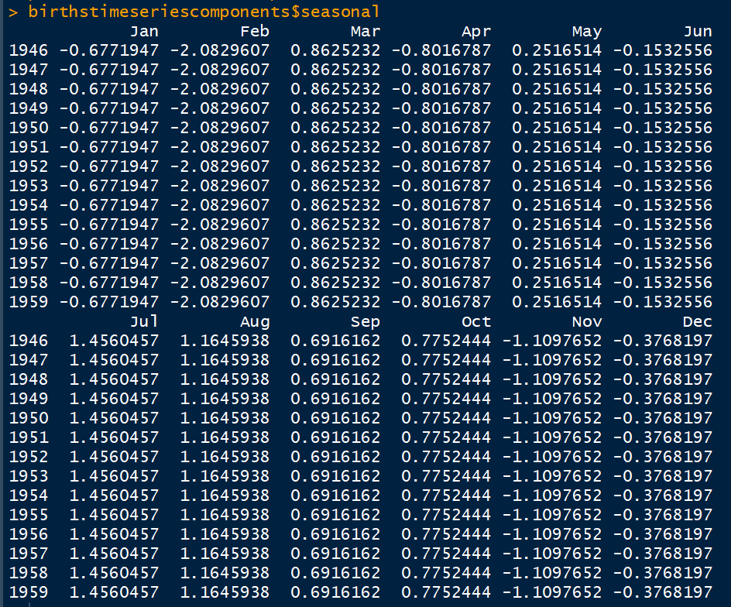
births: Seasonal component

Slide 12
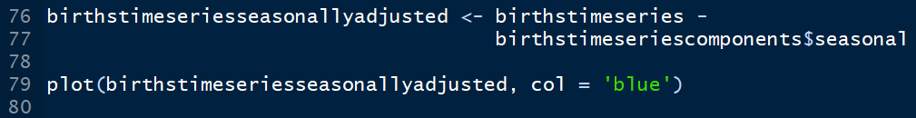
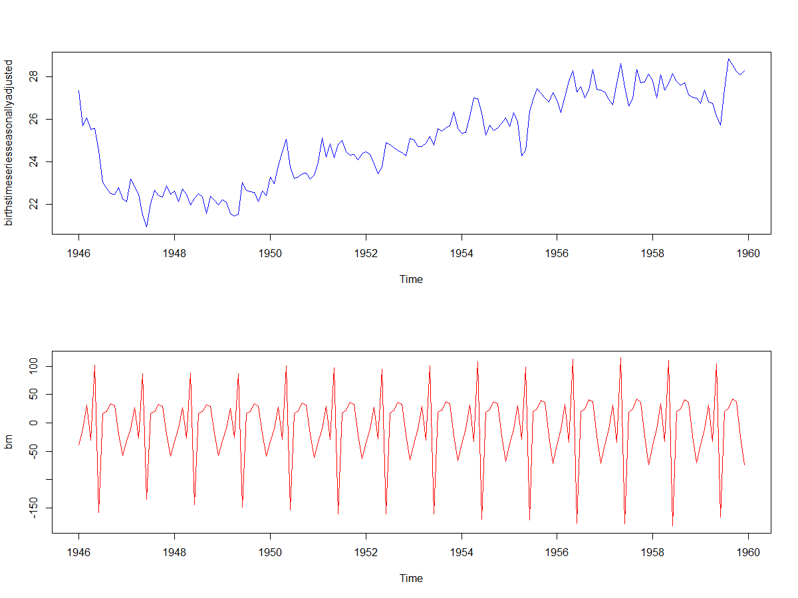
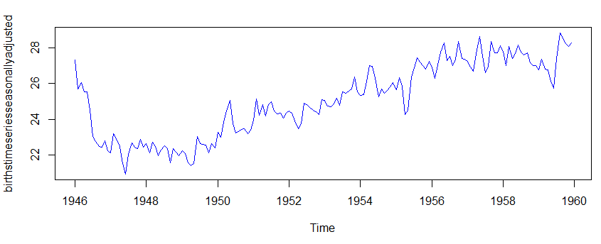
De-seasonalized births
No seasonality

Slide 13
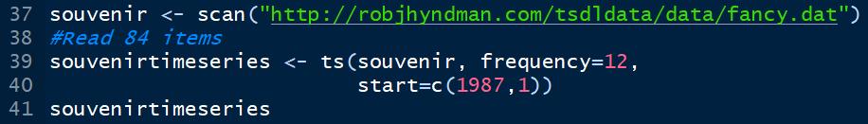

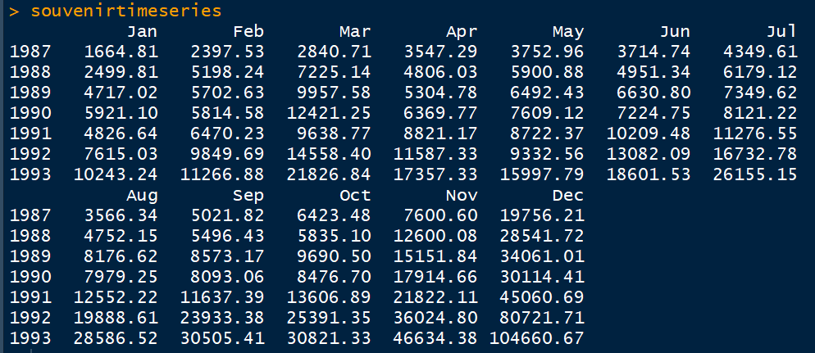
Data: souvenir

Slide 14

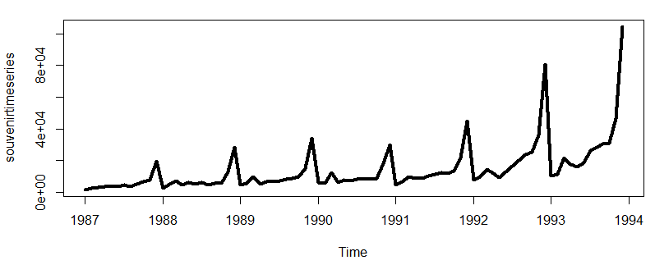
Data: souvenir
It looks like that information is hidden and we are not able to see

Slide 15
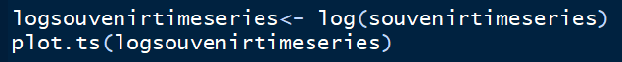
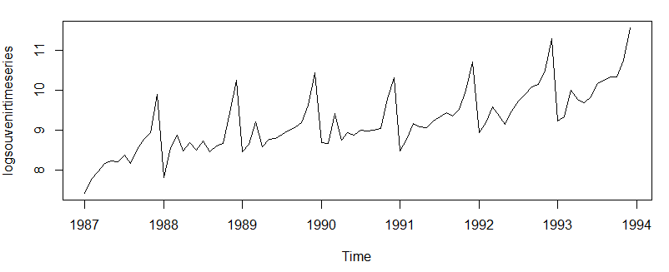
Take log
Data: souvenir
Now better

Slide 16

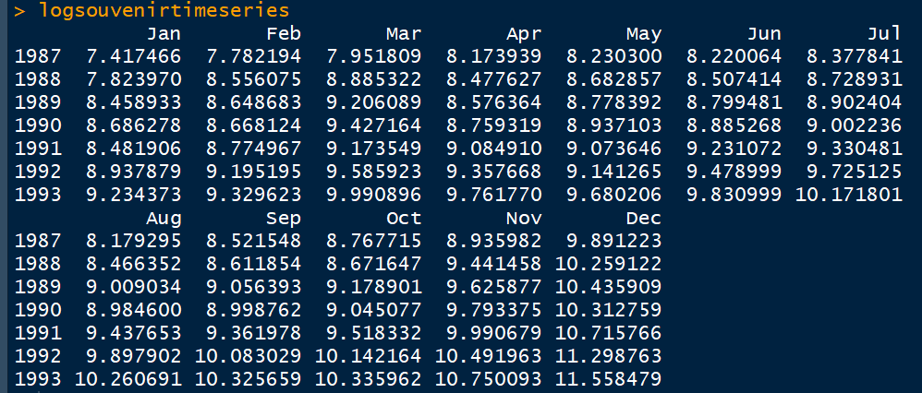
Data: souvenir

Slide 17

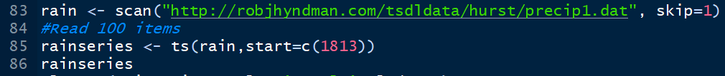
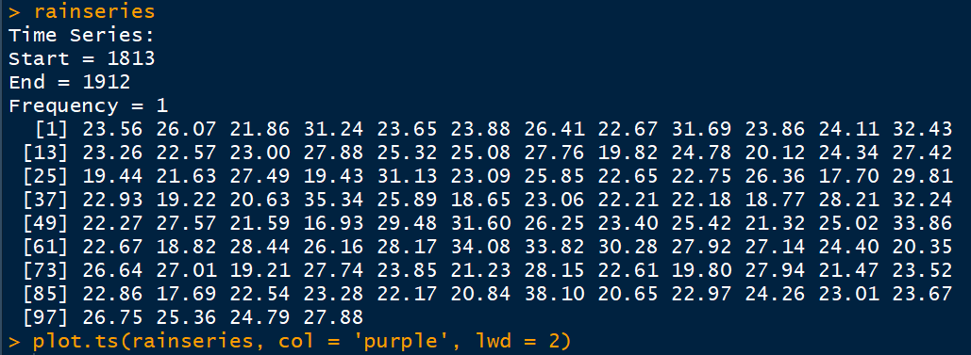
Data: rain

Slide 18
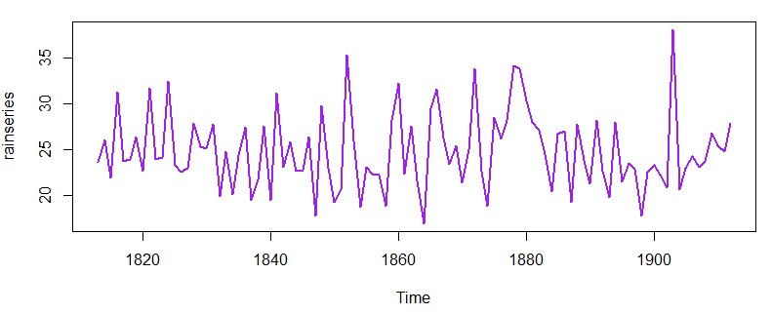
Data: rain
It looks like Kings, Births or Souvenir?

Slide 20
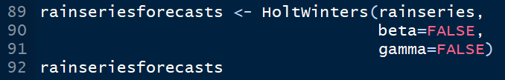
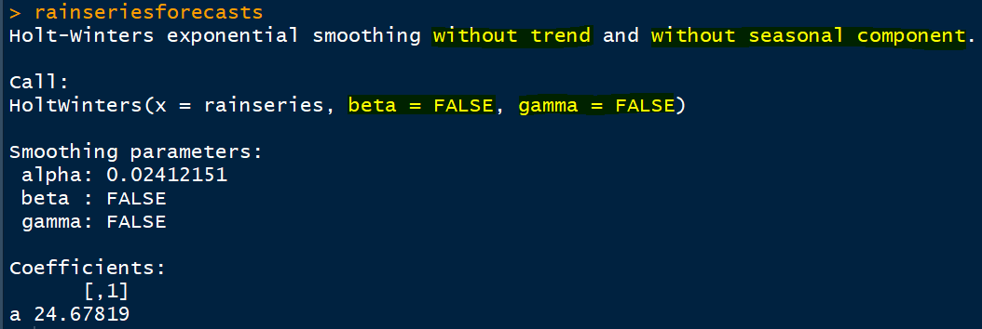
Data: rain

Slide 21

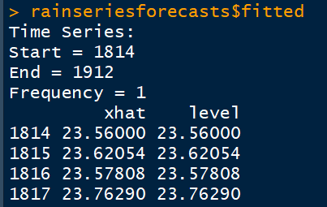
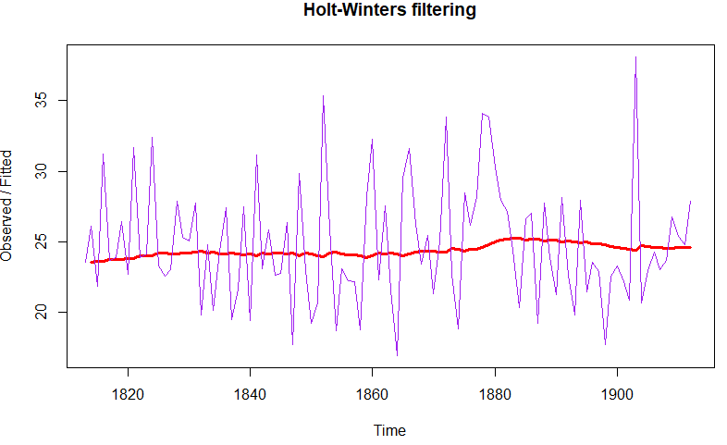
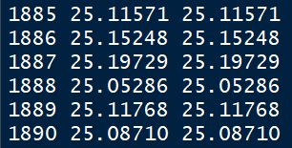
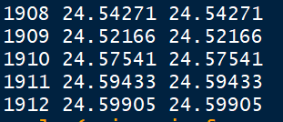
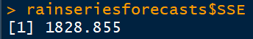
Holt-Winters: rain

Slide 22
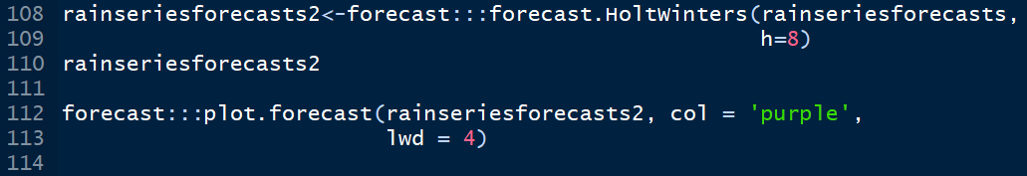
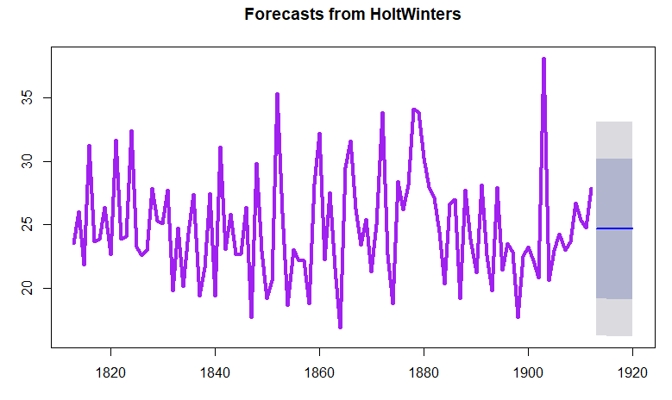
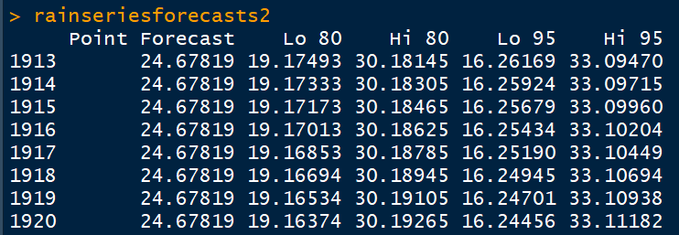
Holt-Winters: rain

Slide 23

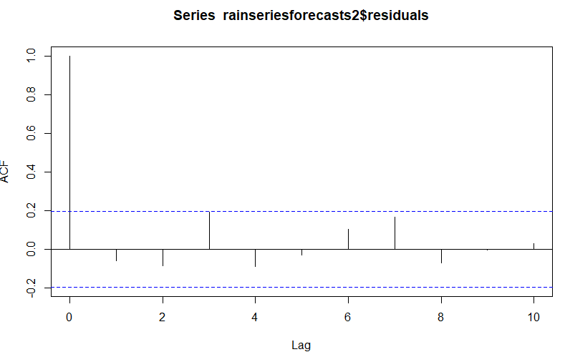
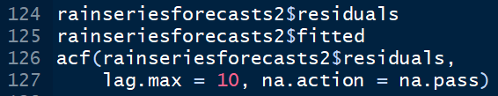
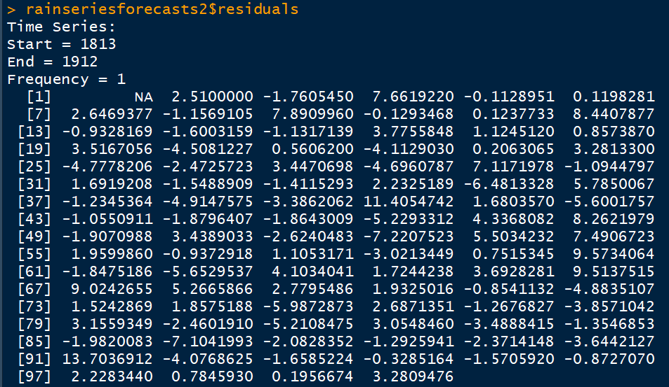

Holt-Winters: rain
26.07-23.56 = 2.51

Slide 24


Holt-Winters: rain
Ho: There is NO significant auto-correlation

Slide 25



Holt-Winters: rain

Slide 26




Holt-Winters: rain
As it is approximately Normally Distributed, FURTHER improvement in model is not needed

Slide 27



Data: skirts

Slide 28


Data: skirts

Slide 29



Holt-Winters: skirts

Slide 30


Holt-Winters: skirts

Slide 31


Holt-Winters: skirts
1st value = 617,
2nd value = 608
b.start = 617-608 = 9

Slide 32

Holt-Winters: skirts
Rain

Slide 33

Holt-Winters: skirts
1 out of 20 has crossed limits! No worries as we are working with 5% LOS

Slide 34

Holt-Winters: skirts

Slide 35


Holt-Winters: skirts
So, p-value higher than 0.05 is good!

Slide 36



Holt-Winters: skirts

Slide 37


Data: souvenir

Slide 38


Data: souvenir

Slide 39

Data: souvenir

Slide 40



Data: souvenir

Slide 41



Holt-Winters: souvenir
Red line is original

Slide 42


Holt-Winters: souvenir

Slide 43


Holt-Winters: souvenir
Rain
Skirts

Slide 44



Holt-Winters: souvenir

Slide 45


Holt-Winters: souvenir

Slide 46



Holt-Winters: souvenir

Slide 47


Holt-Winters: souvenir

Slide 48



Holt-Winters: souvenir: Additive vs Multiplicative

Slide 49


Holt-Winters: souvenir: Additive vs Multiplicative

Slide 50


Holt-Winters: souvenir: Additive vs Multiplicative
Hardly any difference!

Slide 51


Holt-Winters: souvenir: Additive vs Multiplicative

Slide 52


Holt-Winters: souvenir: Additive vs Multiplicative

Slide 53



Holt-Winters: souvenir: Additive vs Multiplicative
Hardly any difference!

Slide 54



Holt-Winters: souvenir: Additive vs Multiplicative
Changed PI = TRUE,
lwd = 4 & 3
Hardly any difference!

Slide 55


Holt-Winters: souvenir: Additive vs Multiplicative
Hardly any difference!
Look at RMSE values

Slide 56
Auto Regressive Integrated Moving Averages

Slide 57

Stationarity: Series without trend and seasonality

Slide 58



Data: skirts

Slide 59


Differencing: skirts

Slide 60


Differencing: kings

Slide 61



Differencing: kings

Slide 62



ACF: kings differenced

Slide 63



PACF: kings differenced

Slide 64


Slide 65

Stationarity Check: ADF test

Slide 66


Auto Regressive Integrated Moving Averages
Differencing (d)
Auto Regression (p)
Moving Average
(q)
Keep an eye on aic [lowest is the best!]

Slide 67

Auto Regressive Integrated Moving Averages: Forecasts

Slide 68


ARIMA: ACF & PACF

Slide 69


Stand alone line diagram of residuals

Slide 70




Histogram of residuals

Slide 71


Lets confirm statistically

Slide 72


Acid Test: Accuracy
Can we improve the accuracy?

Slide 73



